Slide 1

Equation to Animation: Crafting Dynamic Math Visuals on the Web
Slides
https://bit.ly/codemash2025-math-precompiler

Slide 2


Courtney Yatteau
Developer Advocate at Esri
@c_yatteau
courtneyyatteau
@cyatteau.bsky.social

Slide 3
Workshop Goals
Understand data visualization basics
Master key libraries
Build interactive visuals
Integrate geospatial elements
Apply concepts in real projects

Slide 4
Agenda
Introduction
2. Tools & Setup
3. Chart.js
4. D3.js
5. Wrap-Up
Goals & value of data visualization.
Overview of D3.js, Chart.js, and environment setup.
Building basic charts and graphs.
Creating customizable and unique charts and graphs.
Key takeaways and Q&A.

Slide 5
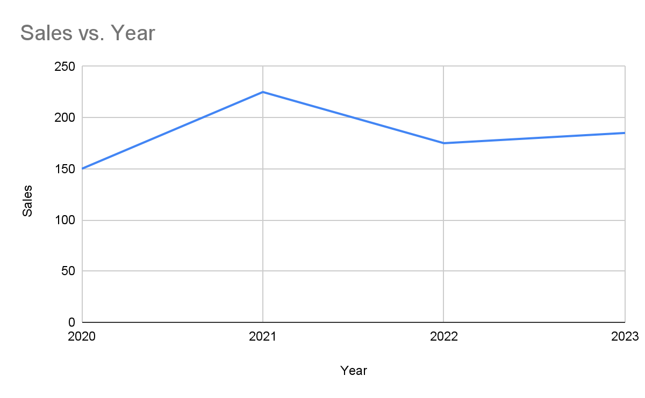
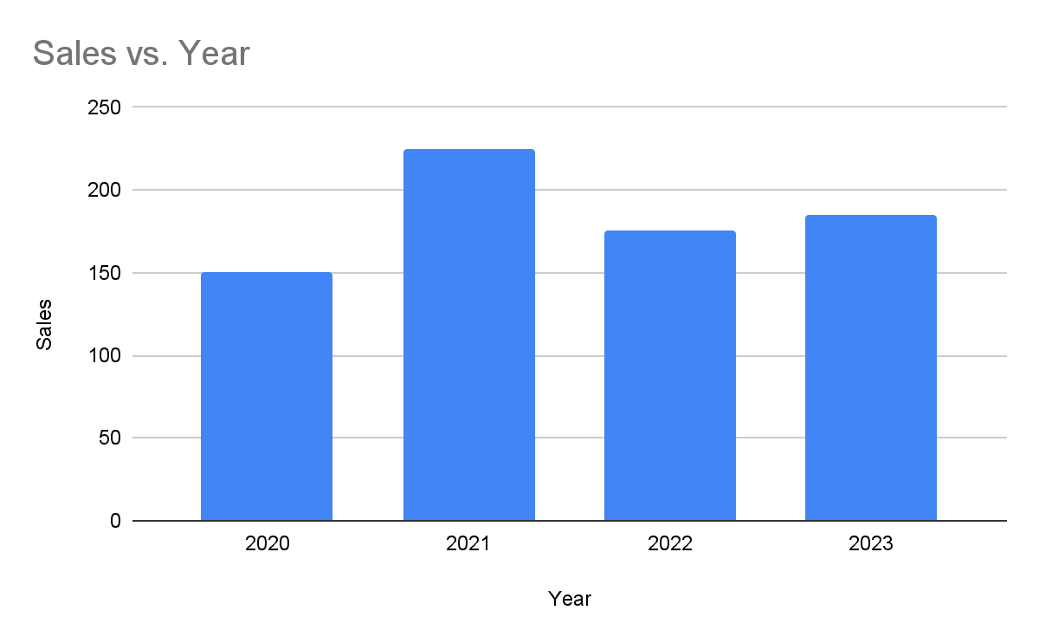
Why Data Visualization?
Year | 2020 | 2021 | 2022 | 2023
Sales | 150 | 225 | 175 | 185

Slide 6
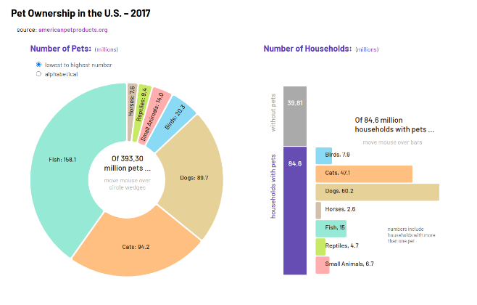
Interactivity

Slide 7
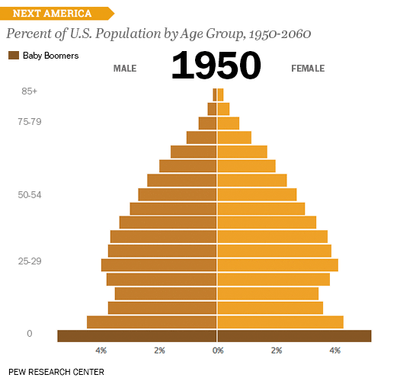
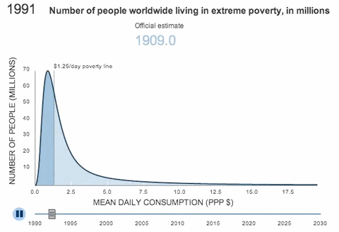
Real-World Examples

Slide 8






Tools & Setup
Visual Studio Code
Install here.
VS Code Extensions
Live Server - install here
Prettier - install here
CDN Links for JS Libraries
<script src="https://cdn.jsdelivr.net/npm/chart.js@4.4.7/dist/chart.umd.min.js"></script>
<script src="https://cdn.jsdelivr.net/npm/d3@7.9.0/dist/d3.min.js"></script>
Workshop Modules Site
Sign up here

Slide 9
Visual Studio Code Setup
Stepup: HTML file shortcut (! + Enter)
Test out Extensions
Prettier
Live Server

Slide 10
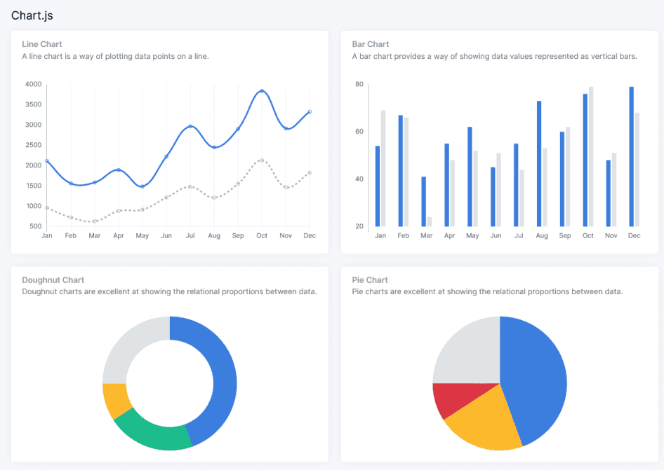
What is Chart.js
Chart.js: A simple, easy-to-use JS library for interactive charts.
Supported Chart Types: Area, Bar, Bubble, Doughnut and Pie, Line, Polar Area, Radar, Scatter.
Why Chart.js?: Lightweight, beginner-friendly, great for basic charts with some interactive features.

Slide 11
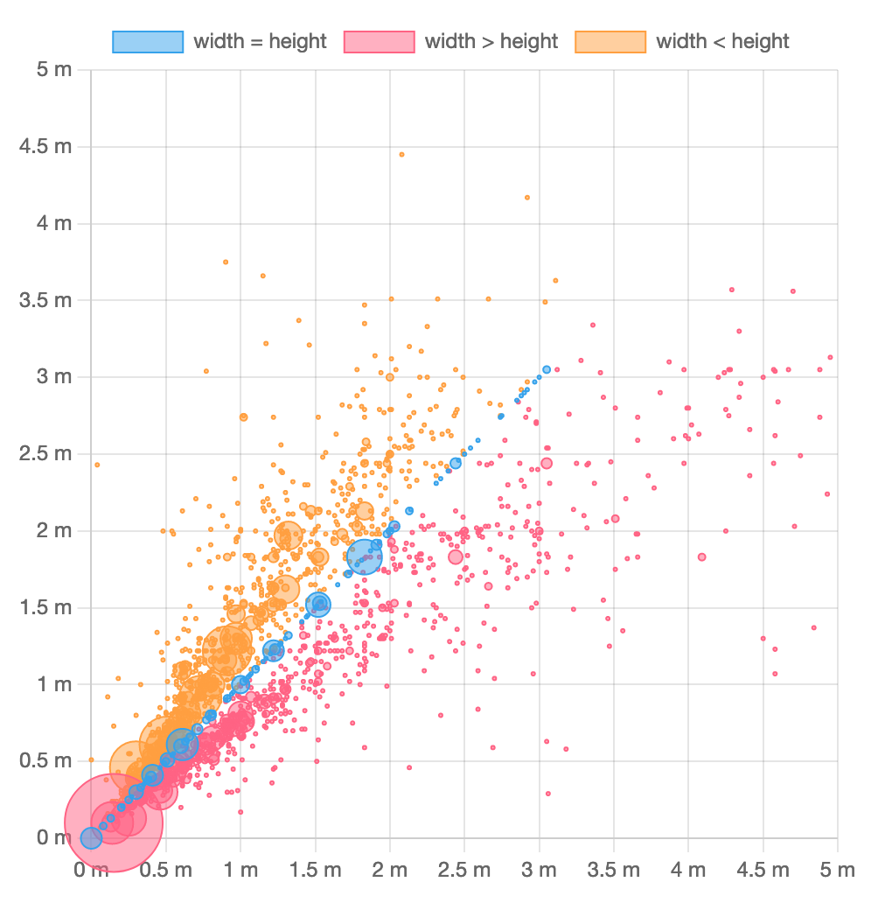
Chart.js - Rendering
Canvas Rendering: Renders charts on an HTML5 canvas.
Performance: Ideal for large datasets (no DOM nodes to manage).
Limitation: No CSS styling—customization through built-in options or custom plugins.

Slide 12
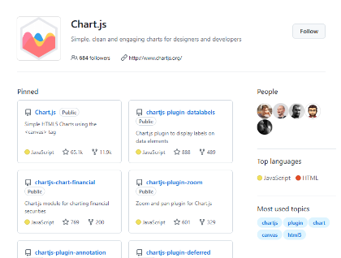
Chart.js - History and Community
Popularity:
GitHub Stars: ~60,000
npm Downloads: ~2.4 million weekly
History: Created in 2013, open-source, MIT license.
Community: Actively maintained by an open-source community with lots of plugins.

Slide 13
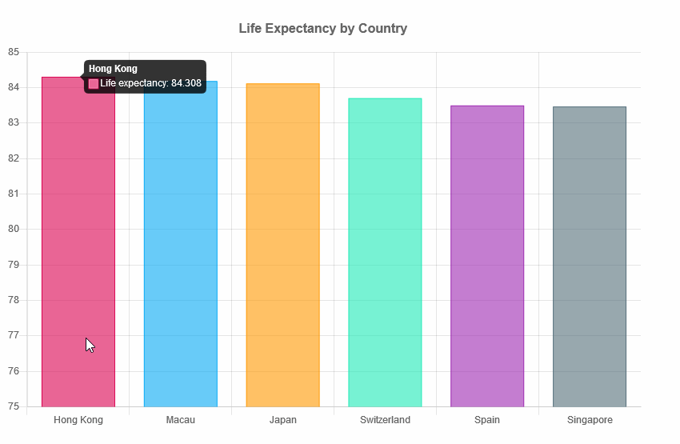
Bar Charts
What is a Bar Chart? A bar chart visualizes comparisons across different categories, where each bar's height indicates its value or frequency.
When to Use Bar Charts: They are perfect for comparing distinct categories and highlighting specific comparisons.

Slide 14
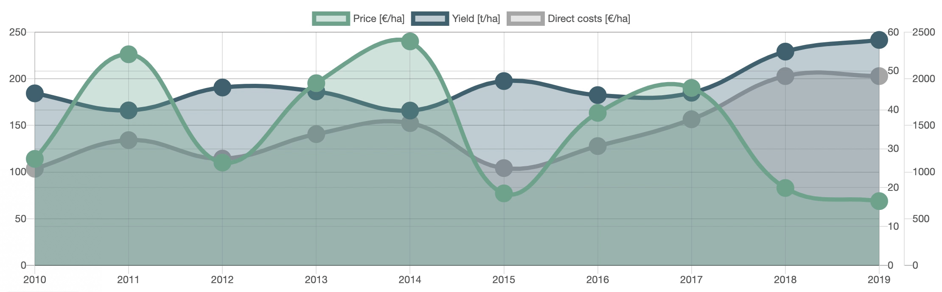
Line Charts
What is a Line Chart?
A line chart displays data points connected by lines.
When to Use Line Charts:
Ideal for visualizing trends and changes over time, especially when comparing data continuously.

Slide 15
Complete Modules 1 and 2 on the Workshop Site
Finished early? Explore the Chart.js site or move onto Module 3!

Slide 16
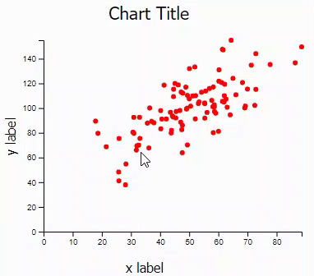
Scatterplot
What is a Scatter Plot?
A scatter plot is used to visualize the relationship between two numeric variables.
Each point represents a pair of values, plotted on the X and Y axes.
When to Use Scatter Plots:
Best for correlation analysis: Shows how two variables are related.
Ideal for visualizing clusters or outliers.
Useful for regression analysis, identifying patterns, or comparing distributions.

Slide 17

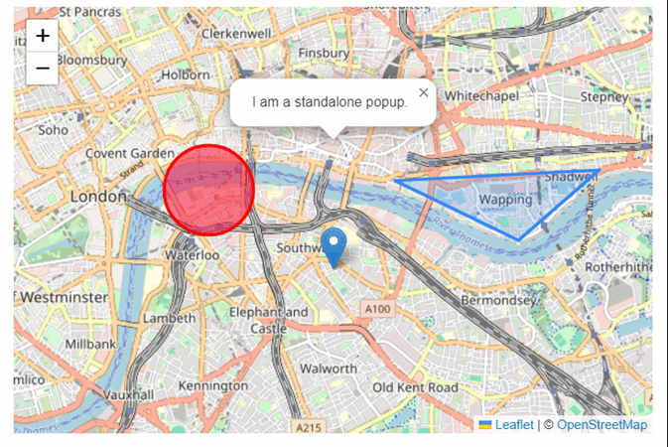
Leaflet
Leaflet: JavaScript library for interactive maps.
Lightweight: Only about 42 KB of JS and it’s easy to integrate with charts.
Use Case: Perfect for embedding maps in web applications.
Note: View is set with an initial latitude and longitude. You can use this geocoding search tool for finding locations.

Slide 18
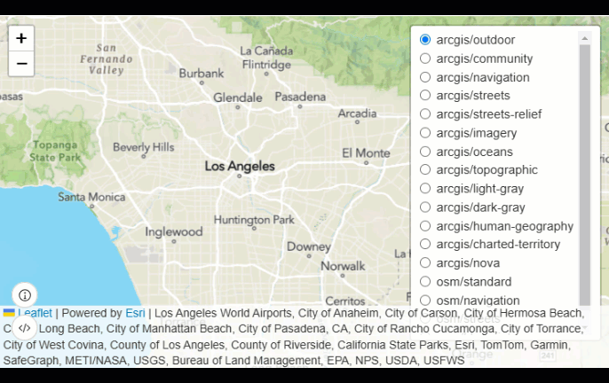
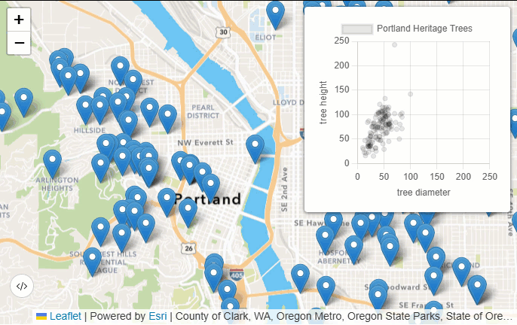
Esri Leaflet
Esri Leaflet: Adds Esri's mapping capabilities to Leaflet.
Features: Access to Esri basemaps, feature layers (e.g. ArcGIS Hub and Living Atlas), and geospatial services.
Combining with Charts: Use map features to dynamically update charts with relevant data.

Slide 19
Complete Module 3 on the
Workshop Site
Finished early? Explore the Leaflet documentation or move onto Module 4!

Slide 20
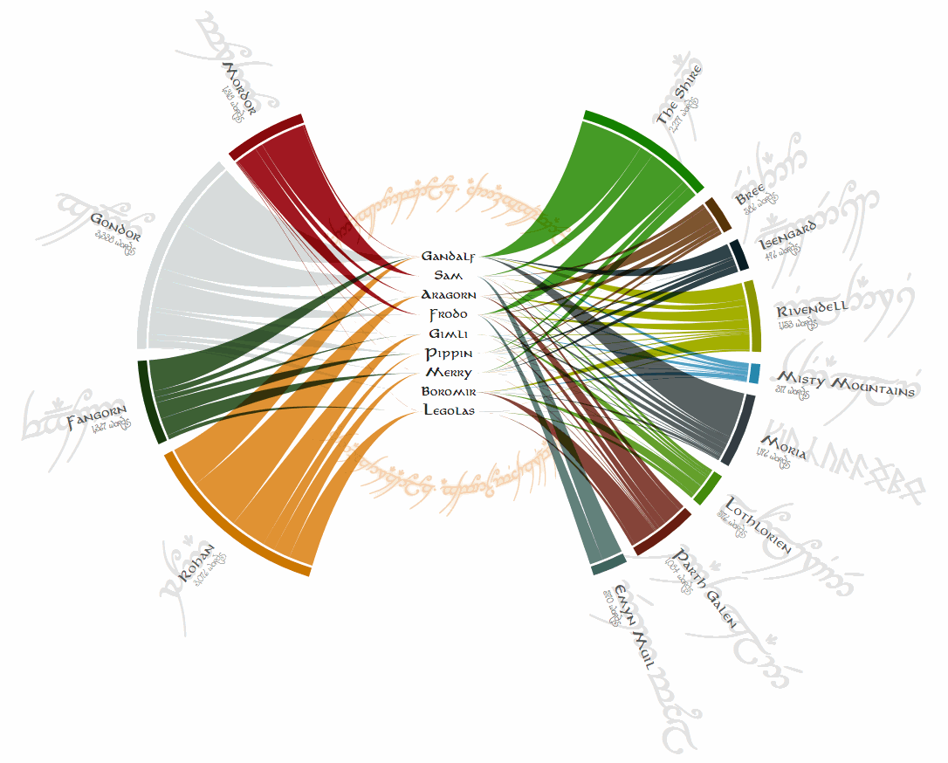
D3.js
D3.js: JS library for creating complex, data-driven visualizations.
Key Feature: Manipulates the DOM based on data.
Why Use D3?: More flexibility and customization than Chart.js.

Slide 21

D3.js and SVGs
SVGs: Uses Scalable Vector Graphics (SVG) for browser rendering.
Complex Visualizations: Create radial charts, bubble charts, force-directed graphs, and more.
Benefits: Ideal for responsive, interactive, and customizable visuals.

Slide 22

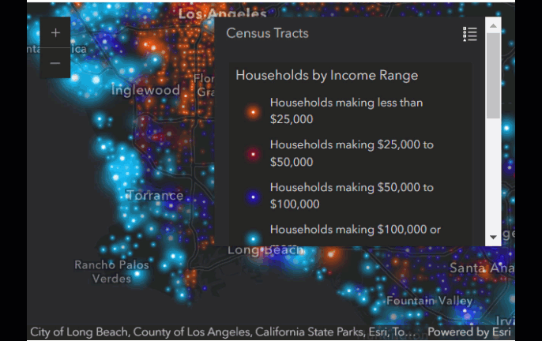
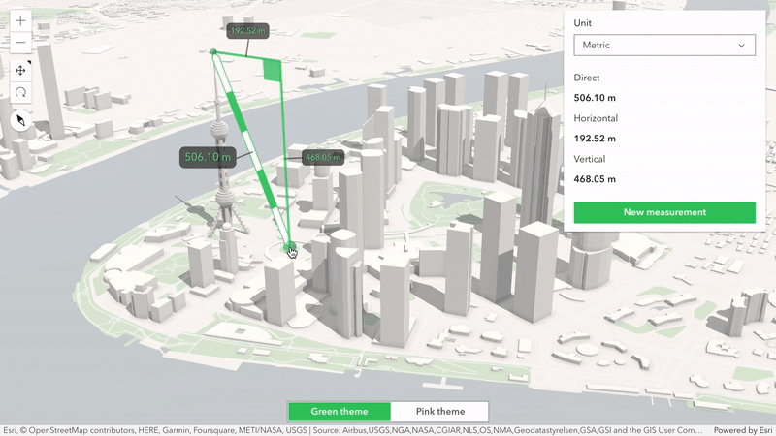
ArcGIS Maps SDK for JavaScript
Advanced GIS Capabilities
Integrated with Esri Services
Robust Data Visualization

Slide 23
How does the ArcGIS Maps SDK for JS Compare to Leaflet/Esri Leaflet?
Feature | ArcGIS Maps SDK for JS | Leaflet/Esri Leaflet
Complexity | More features and capabilities | Simpler, lightweight setup
Data Handling | Efficient with large datasets | Best for smaller datasets
3D & Real-Time | Extensive 3D and real-time support | Limited to basic capabilities
Graphics Rendering | Uses WebGL for complex visuals | Primarily uses DOM rendering

Slide 24
Complete Modules 4 and 5 on the
Workshop Site
Finished early? Explore the d3.js site or revisit any of the demos/modules!

Slide 25
Conclusions
Key Techniques: Explored D3.js, Chart.js, Leaflet, Esri Leaflet, and ArcGIS for dynamic visual storytelling.
Workshop Goals: Improved skills in creating interactive and engaging visualizations.
Next Steps:
Apply skills to new projects.
Share work on platforms like GitHub.
Join and participate in related online communities.

Slide 26
Resources
Chart.js Github Repo
Chart.js Github Awesome list - curated list of Chart.js resources and libraries
Chart.js Site
D3.js Github Repo
D3.js Site
Leaflet Site
ArcGIS Maps SDK for JavaScript Documentation

